Slide 1
Problems – ER Diagram
Steps in ER Modeling
Identify the entities
Find Relationship
Identify key attributes for every entity
Identify other relevant attributes
Draw complete ER diagram with all

Slide 2
ER DIAGRAM
Draw an ER diagram for College Database
Assumptions :
College have many Departments
Each Department can offer any number of courses
Many instructors work in Department.
Each instructor can take any number of courses
A student can enroll in any number of courses
Each course can have any number of students

Slide 3
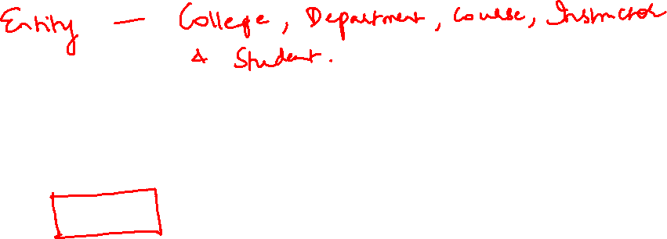

Slide 4
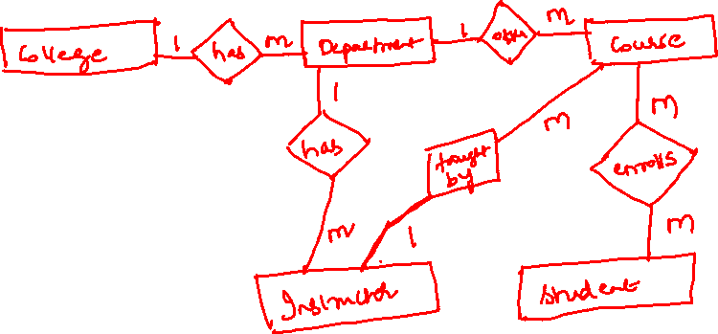
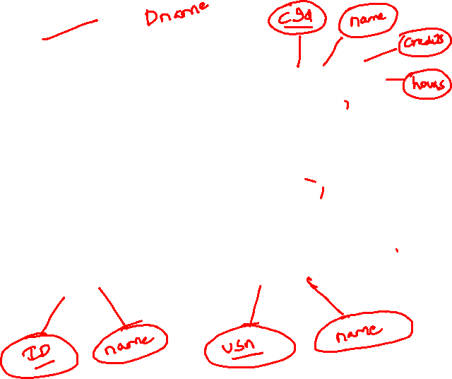
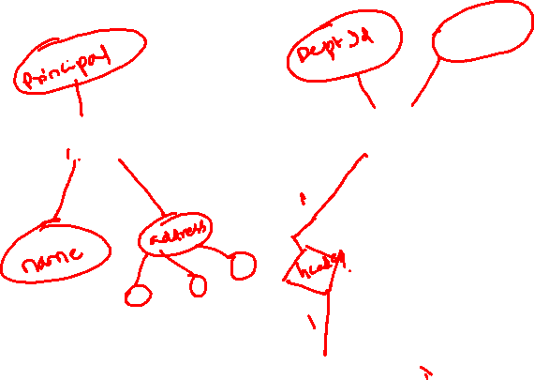

Slide 5
ER DIAGRAM
2) Draw an ER diagram for Employee Database
Assumptions :
Many employees work for one dept
One employee manages dept
Many employees can work for one or more than one project simultaneously
One department controls many projects
Employees can have many dependents

Slide 6

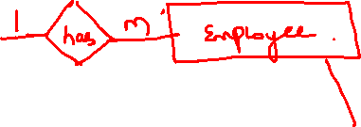
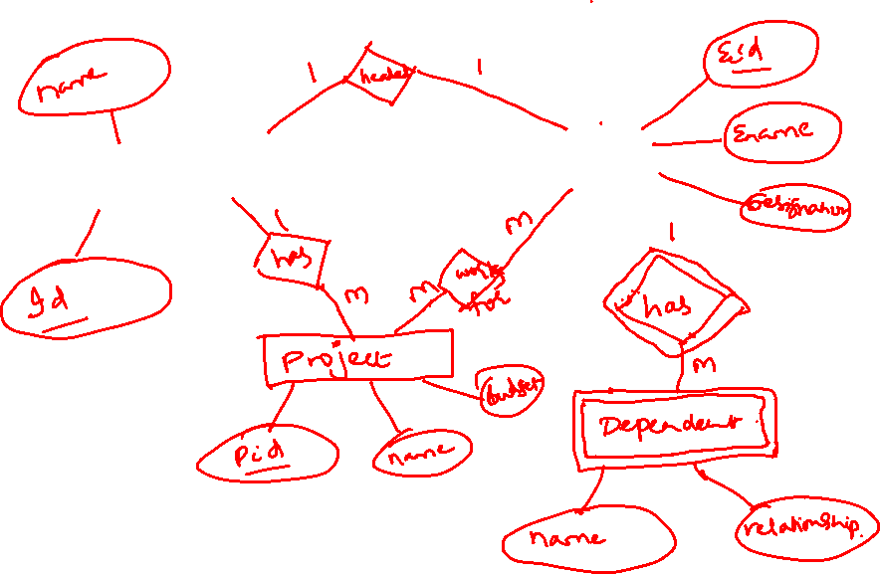

Slide 7
ER DIAGRAM
3) Draw an ER diagram for Hospital Management

Slide 8
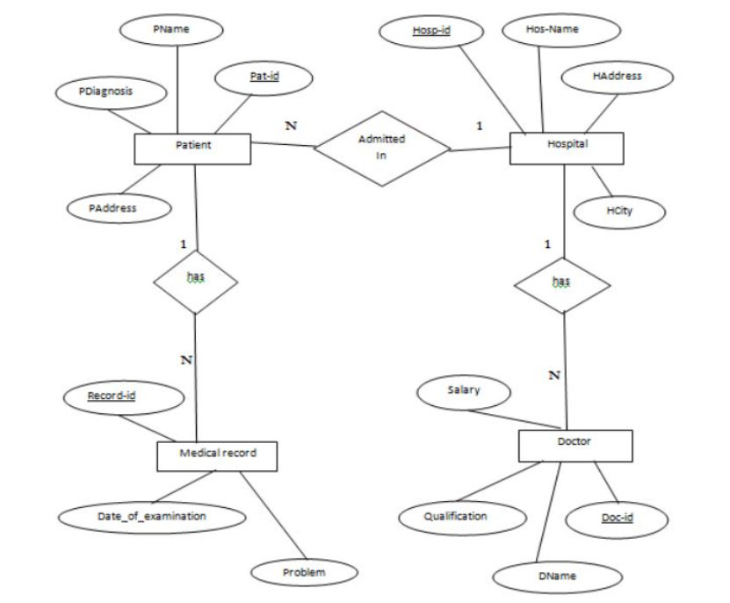
ER DIAGRAM

Slide 9
ER DIAGRAM
4) Draw an ER diagram for Library Database
Assumptions :
A university has multiple libraries, and each library has multiple student members
Each library has its own set of books
A student can borrow from subscribed library
A student can become a member of multiple libraries by paying appropriate fees.

Slide 10
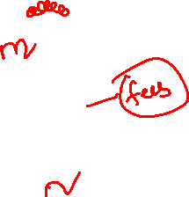
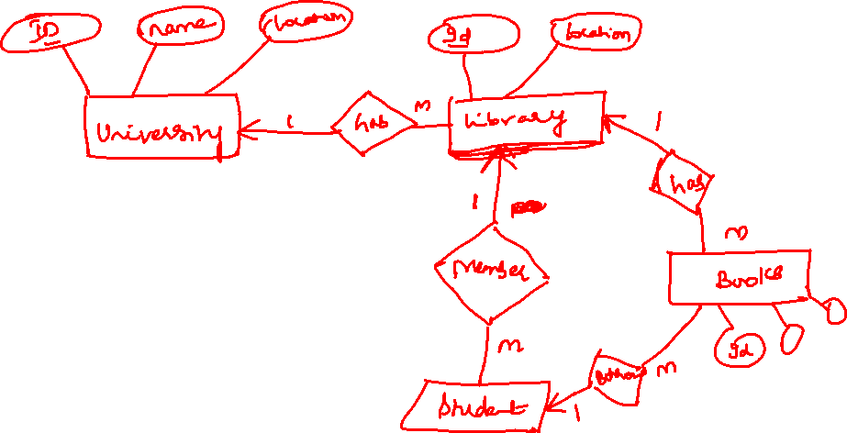
ER DIAGRAM

